Slide 1
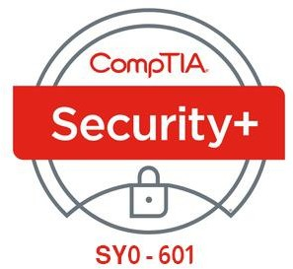

02- Explaining Threat Actors and Threat Intelligence
Ehab Fahmi
Senior Cyber Security Consultant - Instructor

Slide 2
Outlines
2.1- Explain Threat Actor Types and Attack Vectors
2.2- Explain Threat Intelligence Sources

Slide 3
2.1- Explain Threat Actor Types and Attack Vectors
2.2- Explain Threat Intelligence Sources

Slide 4
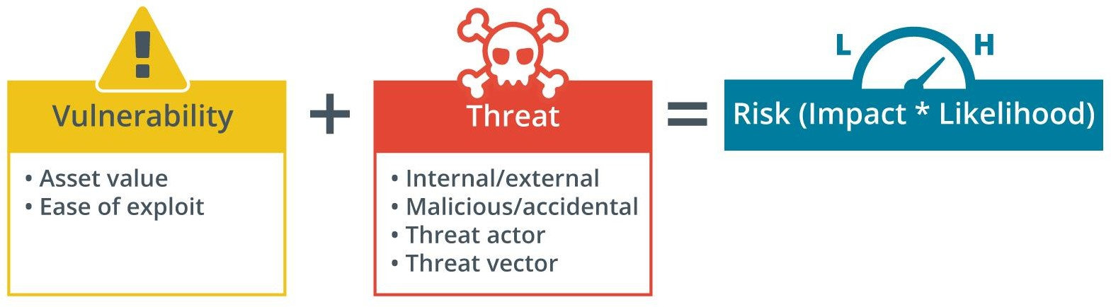
VULNERABILITY, THREAT, AND RISK
As part of security assessment and monitoring, security teams must identify ways in which their systems could be attacked.
These assessments involve vulnerabilities, threats, and risk.

Slide 5
VULNERABILITY, THREAT, AND RISK (cont.)
Vulnerability
is a weakness that could be triggered accidentally or exploited intentionally to cause
a security breach.
Examples of vulnerabilities include:
Improperly configured or installed hardware or software
Delays in applying and testing software and firmware patches
Untested software and firmware patches
The misuse of software or communication protocols
Poorly designed network architecture
Insecure password usage

Slide 6
VULNERABILITY, THREAT, AND RISK (cont.)
Threat
is the potential for someone or something to exploit a vulnerability and breach
security.
A threat may be intentional or unintentional.
The person or thing that poses the threat is called a threat actor or threat agent.
The path or tool used by a malicious threat actor can be referred to as the attack vector.
Risk
is the likelihood and impact (or consequence) of a threat actor exploiting a vulnerability.
To assess risk, you identify a vulnerability and then evaluate the likelihood of it being
exploited by a threat and the impact that a successful exploit would have.

Slide 7
ATTRIBUTES OF THREAT ACTORS
Internal/External
An external threat actor or agent is one that has no account or authorized access to
the target system.
A malicious external threat must infiltrate the security system using malware and/or social engineering.
Note that an external actor may perpetrate an attack remotely or on-premises (by breaking into the company's headquarters, for instance).
It is the threat actor that is defined as external, rather than the attack method.
Conversely, an internal (or insider) threat actor is one that has been granted permissions on the system.
This typically means an employee, but insider threat can also arise from contractors
and business partners.

Slide 8
ATTRIBUTES OF THREAT ACTORS (cont.)
Intent/Motivation
Intent describes what an attacker hopes to achieve from the attack, while
motivation is the attacker's reason for perpetrating the attack.
A malicious threat actor could be motivated by greed, curiosity, or some sort of grievance, for instance.
The intent could be to vandalize and disrupt a system or to steal something.
Malicious intents and motivations can be contrasted with accidental or unintentional
threat actors and agents.
Unintentional threat actors represents accidents, oversights, and other mistakes.

Slide 9
CATEGORIES OF THREAT ACTORS
To fully assess intent and capability, it is helpful to identify different categories of threat actors.
Hackers
Hacker describes an individual who has the skills to gain access to computer systems through unauthorized or unapproved means.
Originally, hacker was a neutral term for a user who excelled at computer
programming and computer system administration.
Hacking into a system was a sign of technical skill and creativity.
The terms black hat (unauthorized) and white hat (authorized) are used to distinguish these motivations.

Slide 10
CATEGORIES OF THREAT ACTORS (cont.)
Hackers (cont.)
Of course, between black and white lie some shades of gray.
A Gray hat hacker (semi-authorized) might try to find vulnerabilities in a product or network without seeking the approval of the owner; but they might not try to exploit any vulnerabilities they find.
A gray hat might seek voluntary compensation of some sort (a bug bounty), but will not use an exploit as extortion.
A white hat hacker always seeks authorization to perform penetration testing of private and proprietary systems.

Slide 11
CATEGORIES OF THREAT ACTORS (cont.)
Script Kiddies
A script kiddie is someone who uses hacker tools without necessarily understanding
how they work or having the ability to craft new attacks.
Script kiddie attacks might have no specific target or any reasonable goal other than gaining attention or proving technical abilities.

Slide 12
CATEGORIES OF THREAT ACTORS (cont.)
Hacker Teams and Hacktivists
The historical image of a hacker is that of a loner, acting as an individual with few
resources or funding.
While any such "lone hacker" remains a threat that must be accounted for, threat actors are now likely to work as part of some sort of team or group.
The collaborative team effort means that these types of threat actors are able to develop sophisticated tools and novel strategies.
A hacktivist group, such as Anonymous, WikiLeaks, or LulzSec, uses cyber weapons to promote a political agenda.
Hacktivists might attempt to obtain and release confidential information to the public domain, perform denial of service (DoS) attacks, or deface websites.

Slide 13
STATE ACTORS AND ADVANCED PERSISTENT THREATS
Most nation states have developed cybersecurity expertise and will use cyber weapons to achieve both military and commercial goals.
The term Advanced Persistent Threat (APT) was coined to understand the
behavior underpinning modern types of cyber adversaries.
Rather than think in terms of systems being infected with a virus or Trojan, an APT refers to the ongoing ability of an adversary to compromise network security—to obtain and maintain access—using a variety of tools and techniques.
State actors have been implicated in many attacks, particularly on energy and health network systems.
The goals of state actors are primarily espionage and strategic advantage, but it is not unknown for countries—North Korea being a good example—to target companies purely for commercial gain.

Slide 14
ATTACK VECTORS
An Attack Vector is the path that a threat actor uses to gain access to a secure system.
In the majority of cases, gaining access means being able to run malicious code
on the target.
Direct access—this is a type of physical or local attack, The threat actor could exploit an unlocked workstation, use a boot disk to try to install malicious tools, or steal a device, for example.
Removable media—the attacker conceals malware on a USB thumb drive or memory card and tries to trick employees into connecting the media to a PC, laptop, or smartphone, For some exploits, simply connecting the media may be sufficient to run the malware, In many cases, the attacker may need the employee to open a file in a vulnerable application or run a setup program.

Slide 15
ATTACK VECTORS (cont.)
Email—the attacker sends a malicious file attachment via email, or via any other communications system that allows attachments, The attacker needs to use social engineering techniques to persuade or trick the user into opening the attachment.
Remote and wireless—the attacker either obtains credentials for a remote access or wireless connection to the network or cracks the security protocols used for authentication, Alternatively, the attacker spoofs a trusted resource, such as an access point, and uses it to perform credential harvesting and then uses the stolen account details to access the network.

Slide 16
ATTACK VECTORS (cont.)
Web and social media—malware may be concealed in files attached to posts or presented as downloads, An attacker may also be able to compromise a site so that it automatically infects vulnerable browser software (a drive-by download).
Cloud—many companies now run part or all of their network services via Internet-accessible clouds, The attacker only needs to find one account, service, or host with weak credentials to gain access, The attacker is likely to target the accounts used to develop services in the cloud or manage cloud systems,They may also try to attack the cloud service provider (CSP) as a way of accessing the victim system.

Slide 17
2.2- Explain Threat Intelligence Sources
2.1- Explain Threat Actor Types and Attack Vectors

Slide 18
THREAT RESEARCH SOURCES
Threat research is a counterintelligence gathering effort in which security companies and researchers attempt to discover the tactics, techniques, and procedures (TTPs) of modern cyber adversaries.
There are many companies and academic institutions engaged in primary cybersecurity research.
Security solution providers with firewall and anti-malware platforms derive a lot of data from their own customers' networks.
As they assist customers with cybersecurity operations, they are able to analyze and publicize TTPs and their indicators.
These organizations also operate honeynets to try to observe how hackers interact with vulnerable systems.

Slide 19
THREAT RESEARCH SOURCES (cont.)
Another primary source of threat intelligence is the dark web.
The deep web is any part of the World Wide Web that is not indexed by a search engine.
This includes pages that require registration, pages that block search indexing, unlinked pages, pages using nonstandard DNS, and content encoded in a nonstandard manner.
Within the deep web, are areas that are deliberately concealed from "regular"
browser access.

Slide 20
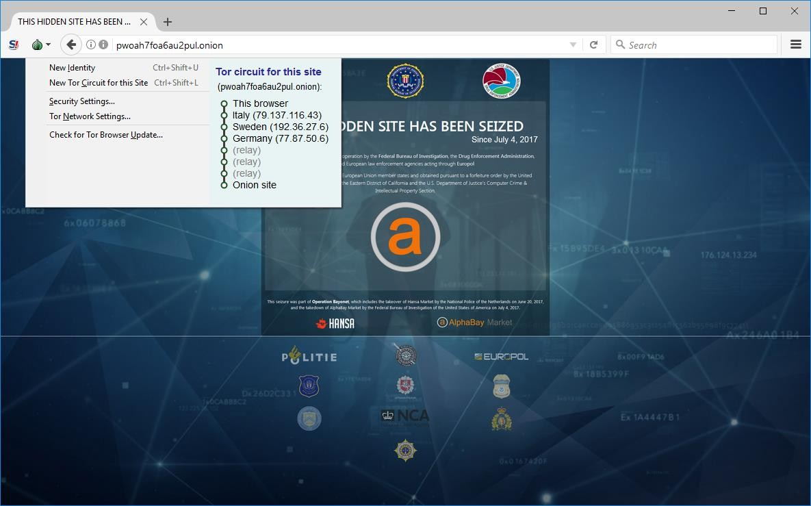
THREAT RESEARCH SOURCES (cont.)

Slide 21
THREAT RESEARCH SOURCES (cont.)
Dark net—a network established as an overlay to Internet infrastructure by software, such as The Onion Router (TOR), Freenet, or I2P, that acts to anonymize usage and prevent a third party from knowing about the existence of the network or analyzing any activity taking place over the network, Onion routing, for instance, uses multiple layers of encryption and relays between nodes to achieve this anonymity.
Dark web—sites, content, and services accessible only over a dark net, While there are dark web search engines, many sites are hidden from them, Access to a dark web site via its URL is often only available via "word of mouth" bulletin boards.

Slide 22
THREAT INTELLIGENCE PROVIDERS
Threat intelligence platforms and feeds are supplied as one of three different commercial models:
Closed/proprietary—the threat research is made available as a paid subscription
to a commercial threat intelligence platform.
The security solution provider will also make the most valuable research available early to platform subscribers in the form of blogs, white papers, and webinars. Some examples of such platforms include:
IBM X-Force Exchange (exchange.xforce.ibmcloud.com)
FireEye (fireeye.com/solutions/cyber-threat-intelligence/threat-intelligence- subscriptions.html)

Slide 23
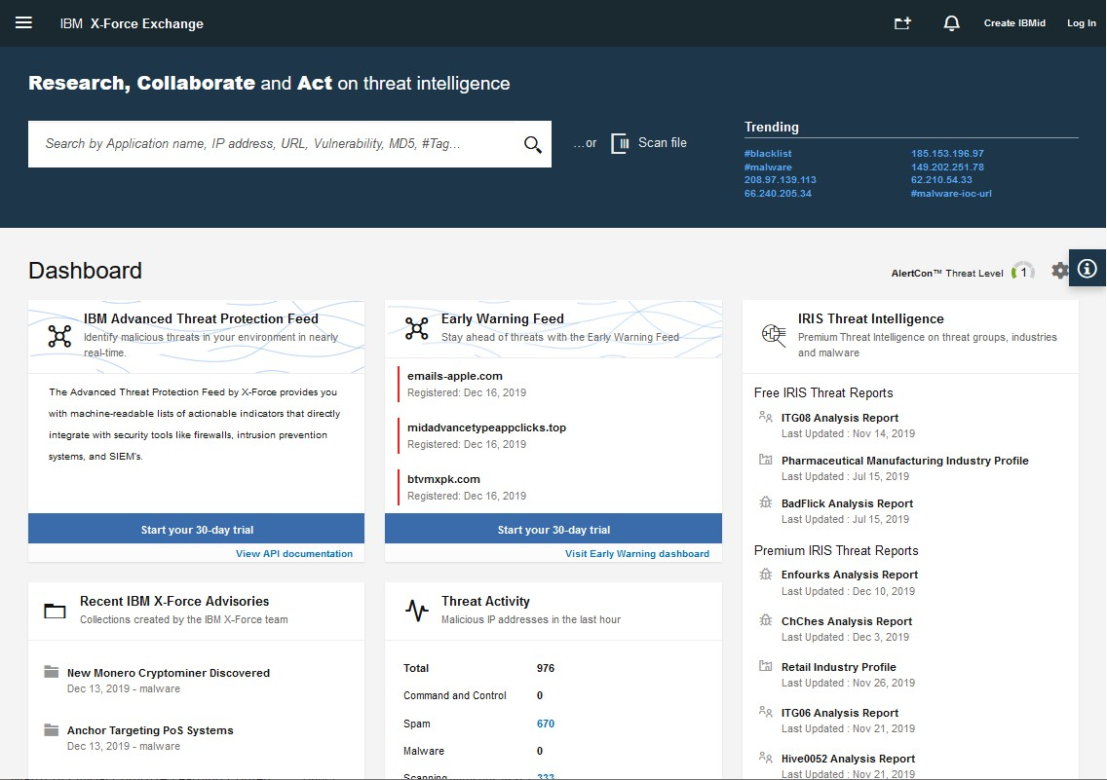
THREAT INTELLIGENCE PROVIDERS (cont.)

Slide 24
THREAT INTELLIGENCE PROVIDERS (cont.)
Vendor websites—proprietary threat intelligence is not always provided at cost.
All types of security, hardware, and software vendors make huge amounts of threat research available via their websites as a general benefit to their customers.
One example is Microsoft's Security Intelligence blog (microsoft.com/security/blog/microsoft-security-intelligence).

Slide 25
THREAT INTELLIGENCE PROVIDERS (cont.)
Public/private information sharing centers—in many critical industries, have been set up to share threat intelligence and promote best practice (nationalisacs.org/member-isacs).
These are sector-specific resources for companies and agencies working in critical industries, such as power supply, financial markets, or aviation. Where there is no coverage by an ISAC, local industry groups and associations may come together to provide mutual support.

Slide 26
THREAT INTELLIGENCE PROVIDERS (cont.)
Open source intelligence (OSINT)—some companies operate threat intelligence services on an open-source basis, earning income from consultancy rather than directly from the platform or research effort.
Some examples include:
AT&T Security, previously Alien Vault Open Threat Exchange (OTX) (otx.alienvault.com)
Malware Information Sharing Project (MISP) (misp-project.org/feeds)
Spamhaus (spamhaus.org/organization)
VirusTotal (virustotal.com)

